Slide 1
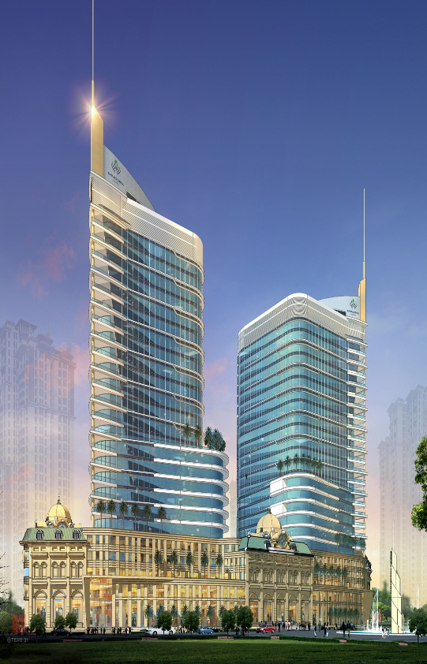
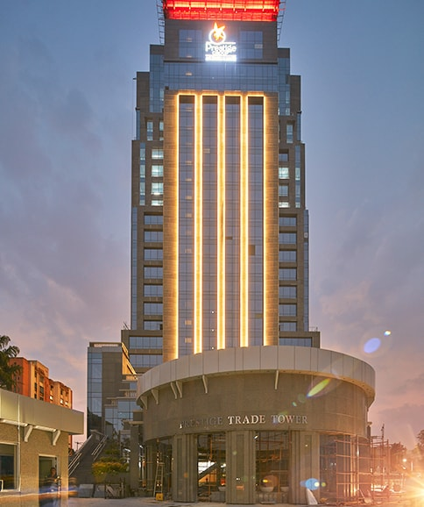
NADIG
CONSULTING
Nadig Consulting
Design Consultancy and Project Delivery

Slide 2
Introduction : Who we are
Our Clients
Services
Systems
Commitment
Our Differentiators : Why NCPL
How we deliver
Nadig Consulting
Design Consultancy and Project Delivery

Slide 3
Who we are
Nadig Consulting is an amalgam of an earlier practice and varied talents bringing together diverse skills and experiences. This merger ensures compatibility and market synergy, so that the Group's success characteristics are preserved, and organisational sustainability. with added value achieved for Client service
The practice is led by Arun Nadig, who has three decades of experience in the structural engineering consultancy having worked for over 15 years, in Brunei, Singapore, and Malaysia.
The practice has established a strong reputation in the market and has over the years developed a reputable client base with a number of major corporate clients in India , Oman and African markets
Nadig Consulting
Design Consultancy and Project Delivery

Slide 4
Who we are
We have
Significant resources ,good financial standing and technical capability
A long standing international experience in the field of Project Management, Engineering Design, Cost Management, Procurement and Project Delivery with reputed multinational firms.
With a combination of local knowledge combined with international exposure.
The unique advantage of running large capital expenditure programs across many countries, and diverse cultures with large multinational clients.
Nadig Consulting
Design Consultancy and Project Delivery

Slide 5
Some of Our Clients
REAL ESTATE & COMMERCIAL
Nadig Consulting
Design Consultancy and Project Delivery

Slide 6
Some of Our Clients
REAL ESTATE & COMMERCIAL
Nadig Consulting
Design Consultancy and Project Delivery

Slide 7
Some of Our Clients
INDUSTRIAL & COROPORATE
Nadig Consulting
Design Consultancy and Project Delivery

Slide 8
Some of Our Clients
PHARMA, R & D
Nadig Consulting
Design Consultancy and Project Delivery

Slide 9
Some of Our Clients
INSTITUTIONAL & COMMERCIAL
Nadig Consulting
Design Consultancy and Project Delivery

Slide 10
Some of Our Clients
INSTITUTIONAL & COMMERCIAL
Nadig Consulting
Design Consultancy and Project Delivery

Slide 11
Capabilities
Sectors:
Institutional and Educational
Retail and Interior Fit outs
Hospitality
Infrastructure : Roads, Sewerage and Water supply,
Townships and Industrial Parks
Oil and Gas
Buildings :Commercial, Industrial and Housing
Capabilities:
Project Feasibility Study
Engineering Economics & Planning
Architectural & Engineering Design
Quantity Surveying
Planning & Scheduling
Construction Management
Nadig Consulting
Design Consultancy and Project Delivery

Slide 12
Process
Design Consultancy
Typical Design Process :
Concept Design
Review and report on the client’s brief.
Provide an assessment of site conditions and constraints.
Develop Design Criteria
Sketch and Schematic Designs, 3D presentation, images
Prepare concept or schematic drawings to adequately explain the design philosophy as it relates to the master plan development
Nadig Consulting
Design Consultancy and Project Delivery

Slide 13
Our Differentiators
Unique Execution Model:
Strategy to Implementation
International Exposure to
Best Practices
Why
US ?
Corporate Pedigree
Collaborative Solutions
Nadig Consulting
Design Consultancy and Project Delivery

Slide 14
What Are Clients Looking For?
Communication
Trust and good rapport
Consideration of clients ideas
Performance on time and within budget
Quick identification of problems and presentation of options,
even if it includes admitting that a mistake was made
Commercial profitability of projects
Creating a culture of excellence
Nadig Consulting
Design Consultancy and Project Delivery

Slide 15
TOWNSHIPS & INFRASTRUCTURE DEVELOPMENT
Nadig Consulting
Design Consultancy and Project Delivery

Slide 16
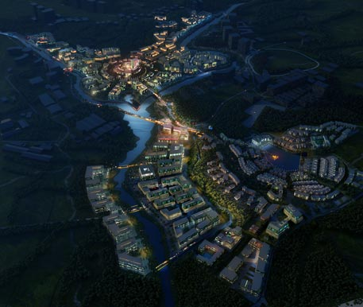
TOWNSHIPS & INFRASTRUCTURE
SMART CITY KOCHI
Nadig Consulting
Design Consultancy and Project Delivery

Slide 17
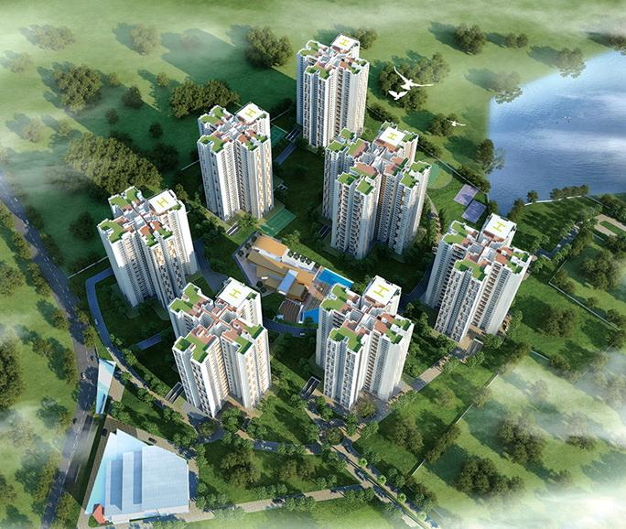
TOWNSHIPS
PRESTIGE FALCON CITY
Nadig Consulting
Design Consultancy and Project Delivery

Slide 18
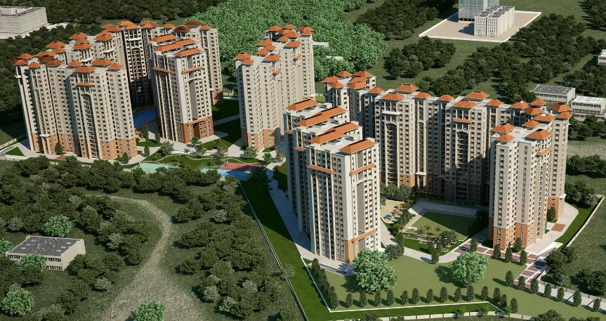
TOWNSHIPS
SKYLARK ITHACA
Nadig Consulting
Design Consultancy and Project Delivery

Slide 19
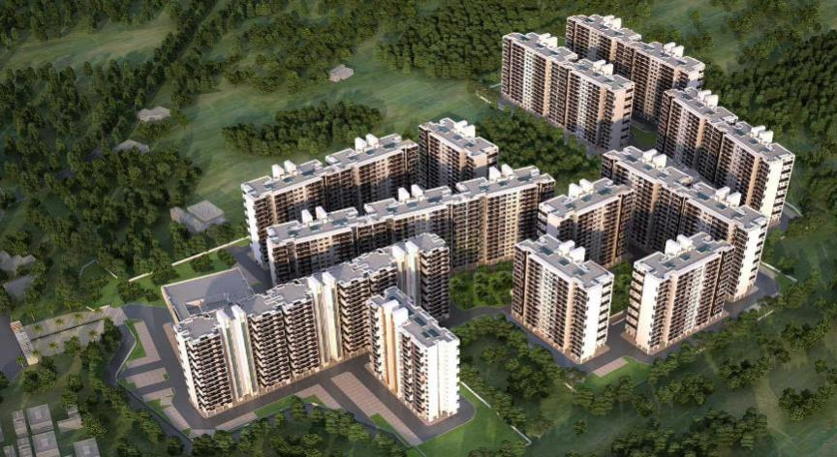
TOWNSHIPS
SBIOA UNITY ENCLAVE
Nadig Consulting
Design Consultancy and Project Delivery

Slide 20
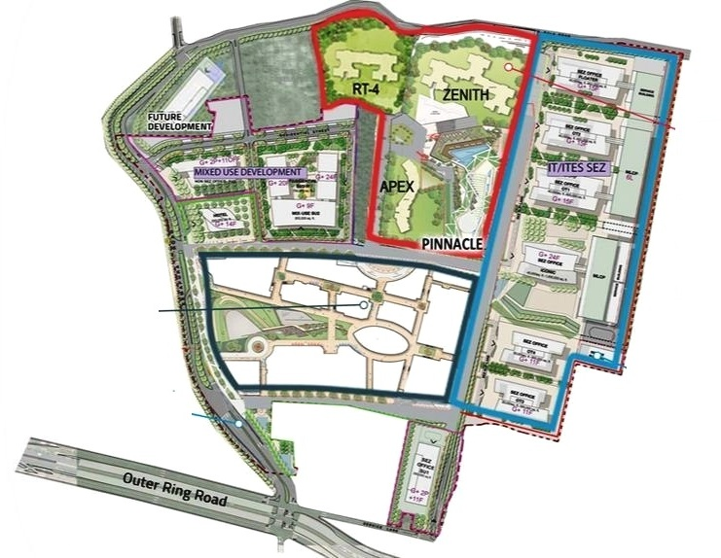
INFRASTRUCTURE DEVELOPMENT PROJECTS
KARLE TOWN CENTRE – PORTAL ROAD
Nadig Consulting
Design Consultancy and Project Delivery

Slide 21
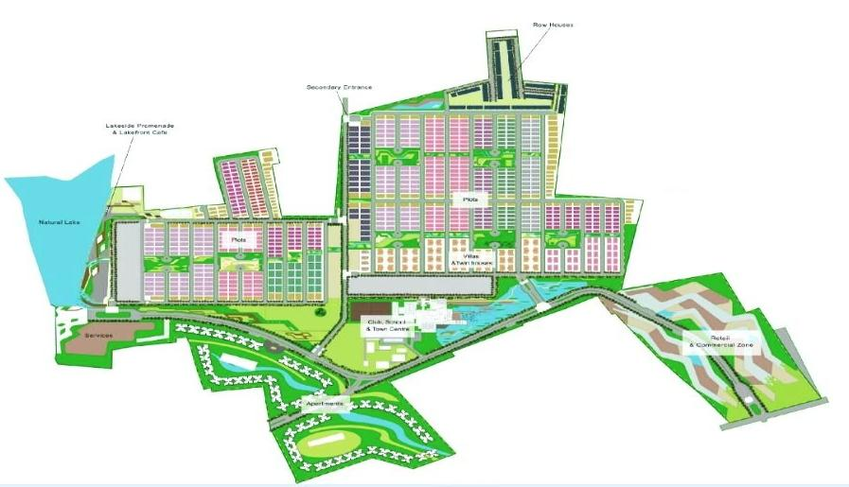
INFRASTRUCTURE DEVELOPMENT PROJECTS
EMBASSY SPRINGS – 284 ACRES
Nadig Consulting
Design Consultancy and Project Delivery

Slide 22
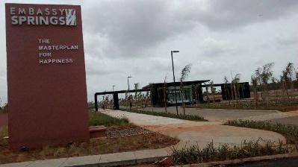
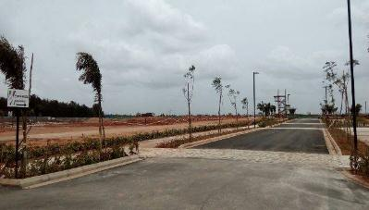
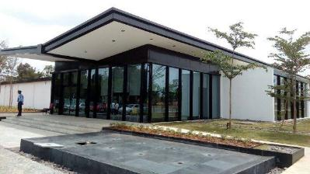
INFRASTRUCTURE DEVELOPMENT PROJECTS
EMBASSY SPRINGS – 284 ACRES
Nadig Consulting
Design Consultancy and Project Delivery

Slide 23
RESIDENTIAL PROJECTS
Nadig Consulting
Design Consultancy and Project Delivery

Slide 24
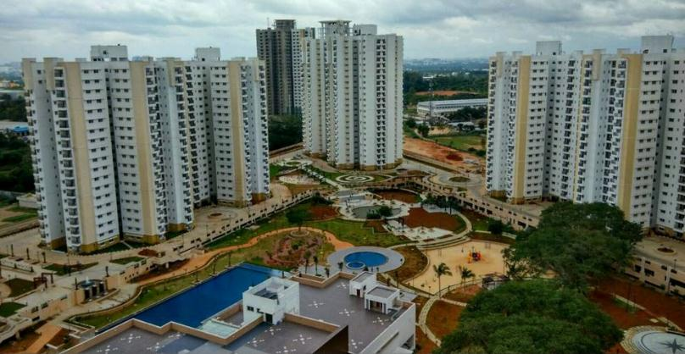
RESIDENTIAL PROJECTS
Prestige Tranquility
Height : 83 Meters
No of Towers : 17 Towers + Club House
Floor Count : 2 Basement + Ground + 27 Floors
Nadig Consulting
Design Consultancy and Project Delivery

Slide 25
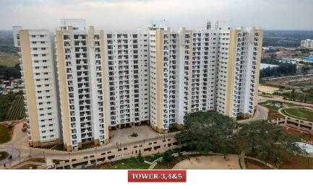
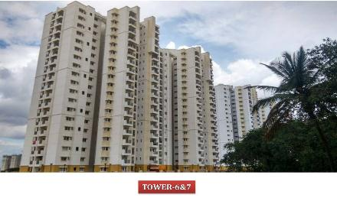
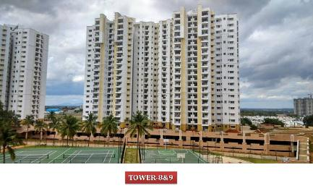
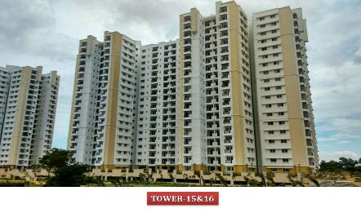
RESIDENTIAL PROJECTS
Prestige Tranquility
Nadig Consulting
Design Consultancy and Project Delivery

Slide 26
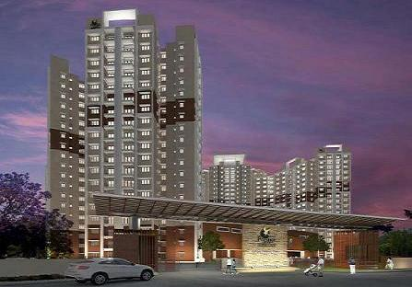
RESIDENTIAL PROJECTS
Prestige Sunrise Park
Architect : RSP
Height : 85 Mtrs (15 Towers)
Floor Count : 2 Basement + Ground + 14-19 Floors
Nadig Consulting
Design Consultancy and Project Delivery

Slide 27
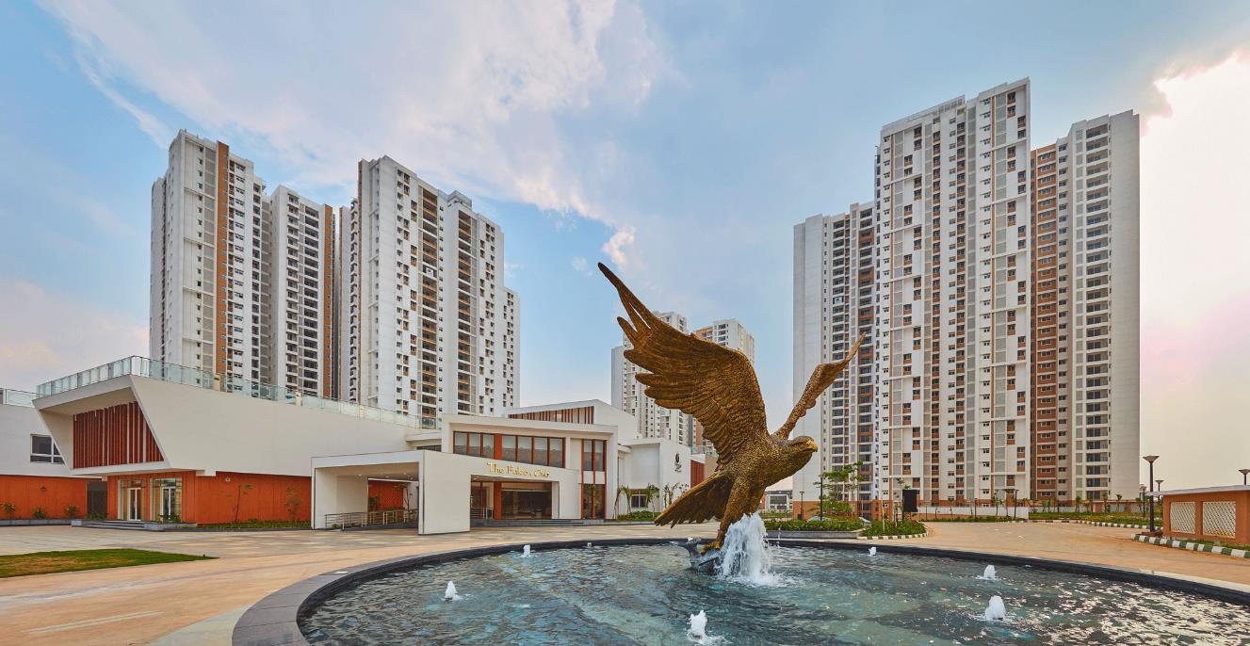
RESIDENTIAL PROJECTS
Prestige Falcon City
Architect : Venkataramanan Associates
Height : 110 Mtrs (20 Towers)
Floor Count : 2 Basement + Ground + 32 Floors
Nadig Consulting
Design Consultancy and Project Delivery

Slide 28
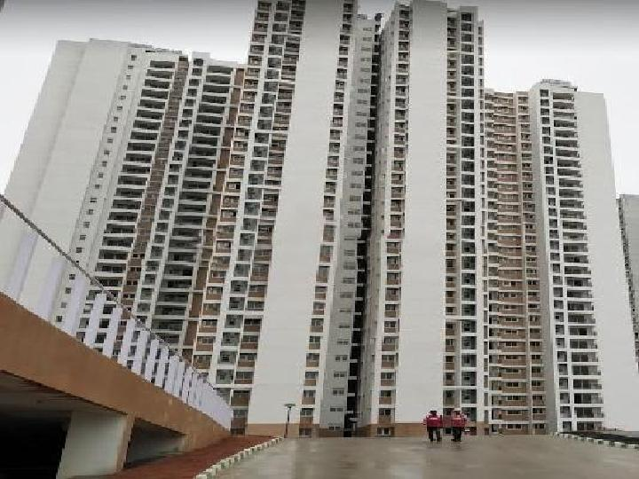
RESIDENTIAL PROJECTS
Prestige Falcon City
Nadig Consulting
Design Consultancy and Project Delivery

Slide 29
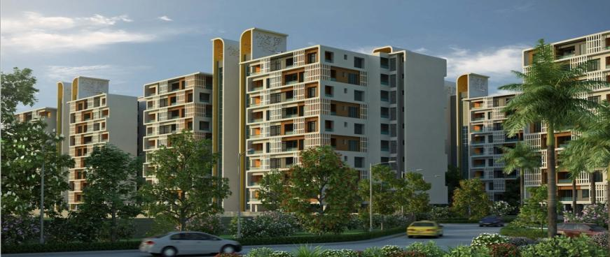
RESIDENTIAL PROJECTS
S B I Township – Unity Enclave, Chennai
Architect : Kembhavi Architects
Height : 60 Mtrs (21 Towers)
Floor Count : 2 Basement + Ground + 15 Floors
Nadig Consulting
Design Consultancy and Project Delivery

Slide 30
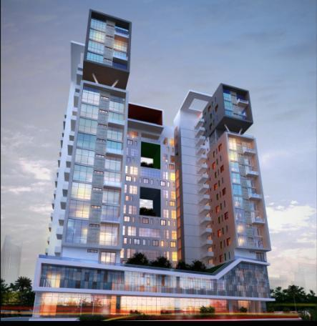
RESIDENTIAL PROJECTS
Unishire Skyvilla
Architect : FHD
Height : 60 Mtrs
Floor Count : 1 Basement + Ground + 18 Floors
Nadig Consulting
Design Consultancy and Project Delivery

Slide 31
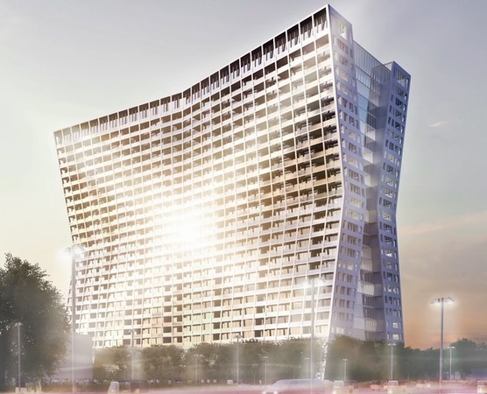
COMMERCIAL PROJECTS
Unishire Xperience
Architect : Hadi Teherani
Height : 95 Mtrs
Floor Count : 1 Basement + Ground + 23 Floors
Status : Design under Progress
Nadig Consulting
Design Consultancy and Project Delivery

Slide 32
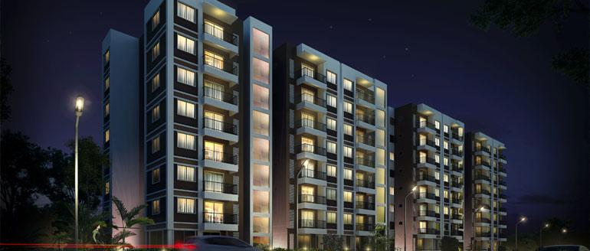
RESIDENTIAL PROJECTS
Ozone Urbana Irene
Architect : Kembhavi Architects
Height : 30 Meters
Floor Count : Stilt + Ground + 8 Floors
Nadig Consulting
Design Consultancy and Project Delivery

Slide 33
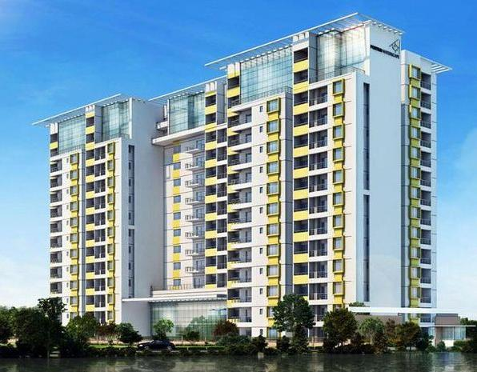
RESIDENTIAL PROJECTS
Fortius Waterscape 2
Architect : R S P
Height : 60 Meters
Floor Count : 2 Basement + Ground + 18 Floors
Nadig Consulting
Design Consultancy and Project Delivery

Slide 34
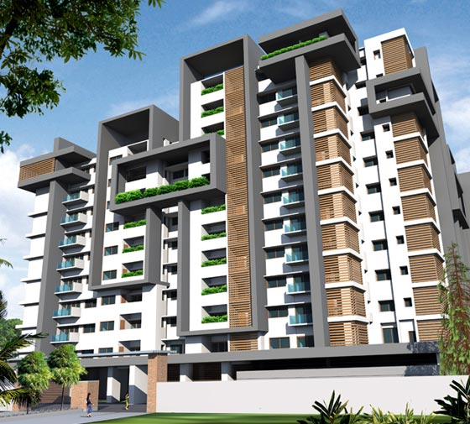
RESIDENTIAL PROJECTS
Century Infinity
Architect :
Balan & Nambisan
Height : 50 Mtrs
Floor Count : 2 Basement + Ground + 12 Floors
Nadig Consulting
Design Consultancy and Project Delivery

Slide 35
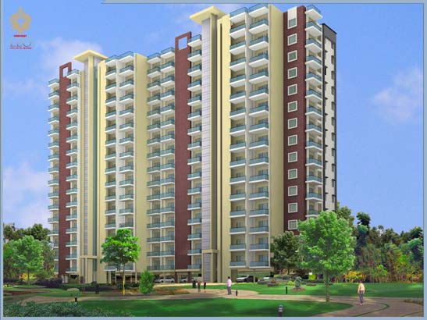
RESIDENTIAL PROJECTS
CONFIDENT LEO, SARJAPUR ROAD
Architect : Binny Jose
Height : 40 Meters
Floor Count : Basement + Ground + 12 Floors
Nadig Consulting
Design Consultancy and Project Delivery

Slide 36
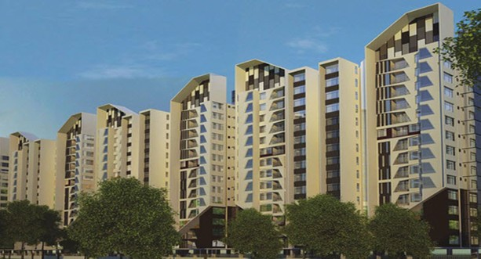
RESIDENTIAL PROJECTS
UNISHIRE ELAN
Architect : Kembhavi Architects
Height : 43 Meters
Floor Count : Basement + Stilt + 10 Floors
Nadig Consulting
Design Consultancy and Project Delivery

Slide 37
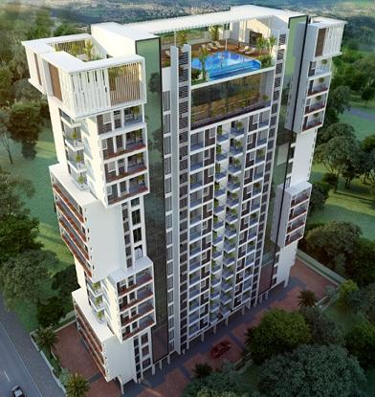
RESIDENTIAL PROJECTS
UNISHIRE LA VIDA
Architect : Aslam Architects
Height : 34 Meters
Floor Count : Basement + Stilt + 8 Floors
Nadig Consulting
Design Consultancy and Project Delivery

Slide 38
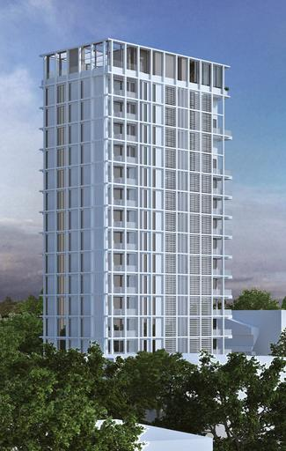
RESIDENTIAL PROJECTS
SAVYASACHI SARAYU
Architect : Andy Fisher Workshop
Height : 65 Meters
Floor Count : 2 Basement + Ground + 14 Floors
Nadig Consulting
Design Consultancy and Project Delivery

Slide 39
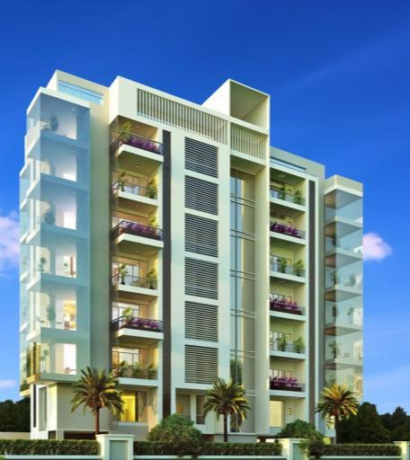
RESIDENTIAL PROJECTS
UNISHIRE PRATYAKSH
Architect : Aslam Architects
Height : 30 Meters
Floor Count : 2 Basement + Ground + 14 Floors
Nadig Consulting
Design Consultancy and Project Delivery

Slide 40
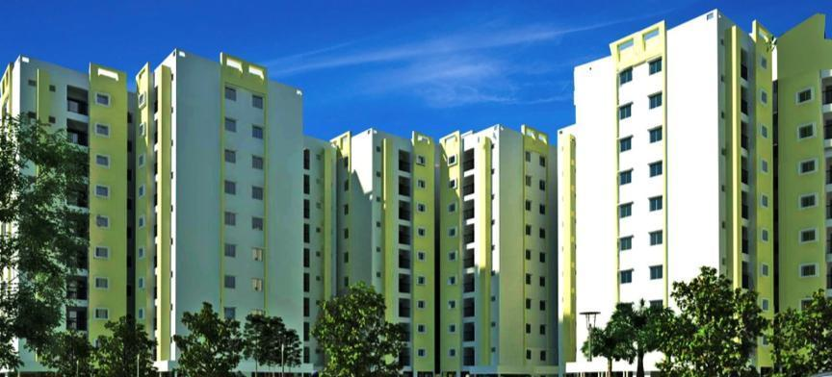
RESIDENTIAL PROJECTS
JANADHAAR SHUBHA PHASE 2
Architect : Venkataramanan Associates
Height : 36 Meters
Floor Count : Stilt + Ground + 8 Floors
Nadig Consulting
Design Consultancy and Project Delivery

Slide 41
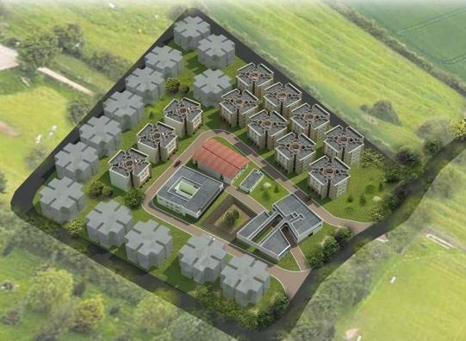
RESIDENTIAL PROJECTS
GIFT CITY, GUJARAT
Architect : Jana Urban Space Foundation
Height : 12 Meters
Floor Count : Ground + 3 Floors ( 22 Blocks)
Nadig Consulting
Design Consultancy and Project Delivery

Slide 42
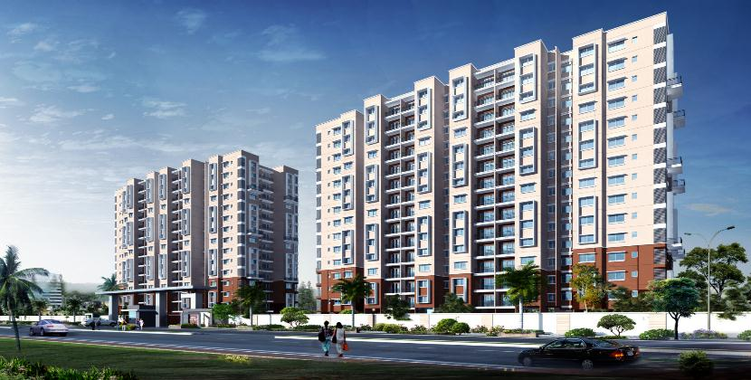
RESIDENTIAL PROJECTS
GARDEN CITY, BANGALORE
Architect : Garden City
Height : 45 Meters
Floor Count : 2 Basement + Ground + 14 Floors ( 23 Towers)
Nadig Consulting
Design Consultancy and Project Delivery

Slide 43
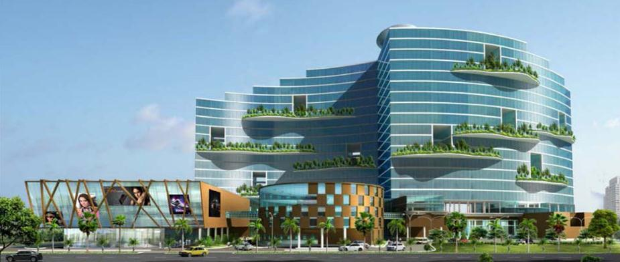
RESIDENTIAL PROJECTS
RAJAGIRI RETREAT CENTRE AT ALUVA, KOCHI
Architect : Aashrami Consultancy and Technology Pvt Ltd.,
Height : 60 Meters
Floor Count : 2 Basement + Ground Floor + 18 Upper Floors
Nadig Consulting
Design Consultancy and Project Delivery

Slide 44
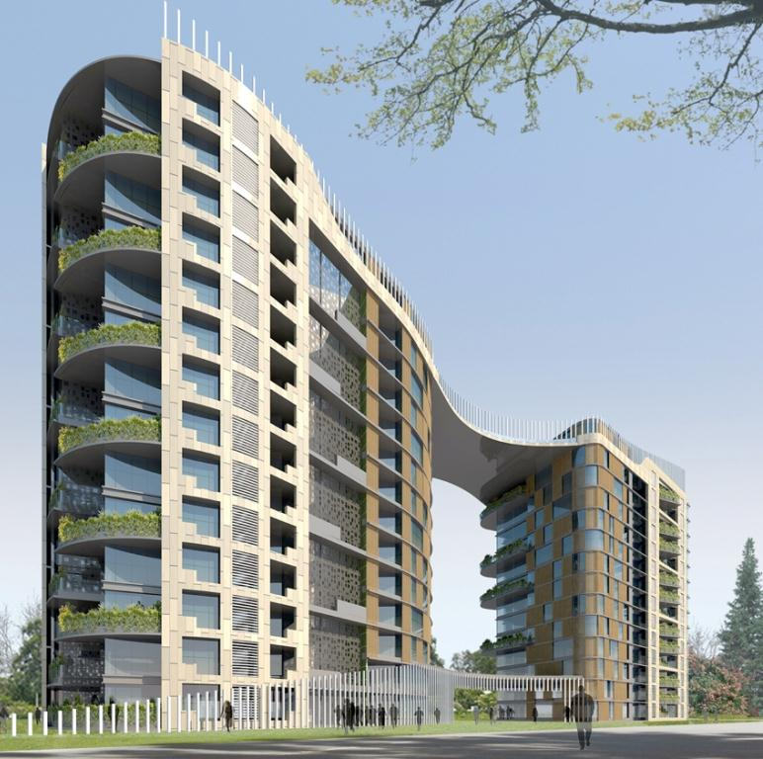
RESIDENTIAL PROJECTS
BRIGADE CALADIUM, BANGALORE
Architect : Zachariah Consultants,
Height : 43 Meters
Floor Count : Basement + Ground Floor + 13 Upper Floors
Nadig Consulting
Design Consultancy and Project Delivery

Slide 45
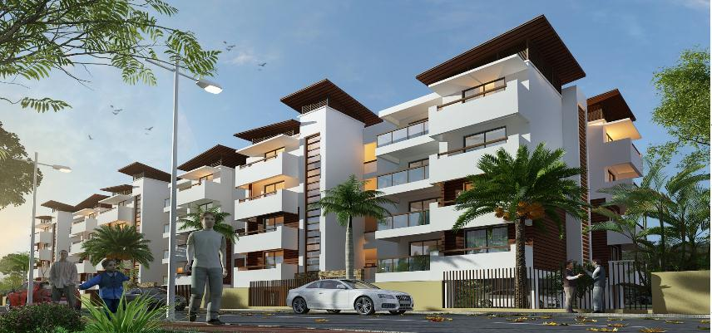
RESIDENTIAL PROJECTS
OZONE URBANA AURA
Architect : Kembhavi Architects
Height : 18 Meters
Floor Count : Stilt + 4 Floors
Nadig Consulting
Design Consultancy and Project Delivery

Slide 46
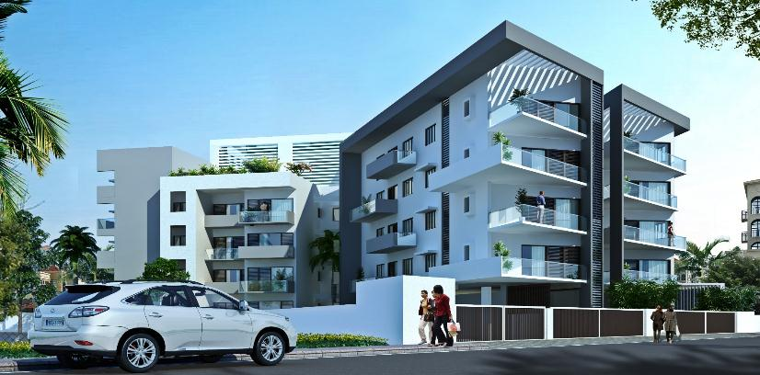
RESIDENTIAL PROJECTS
VERVE ON THE CURVE, BANGALORE
Architect : Synergy,
Height : 15 Meters
Floor Count : Basement + Ground Floor + 4 Upper Floors
Nadig Consulting
Design Consultancy and Project Delivery

Slide 47
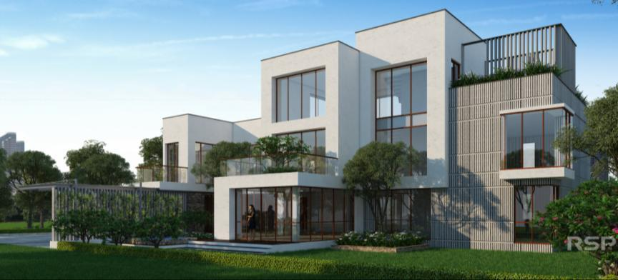
RESIDENTIAL PROJECTS
FORTIUS I V C ROAD VILLAS
Architect : R S P
Height : 11 Meters
Floor Count : Ground + 2 Floors ( 104 Villas)
Nadig Consulting
Design Consultancy and Project Delivery

Slide 48
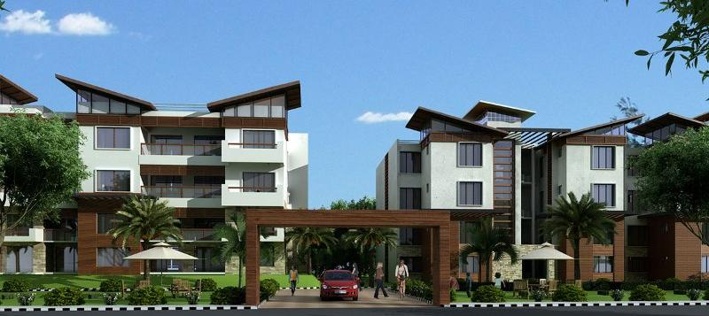
RESIDENTIAL PROJECTS
Ozone Urbana Alcove
Architect : Kembhavi Architects
Height : 15 Meters
Floor Count : Basement + Ground + 3 Floors
Nadig Consulting
Design Consultancy and Project Delivery

Slide 49
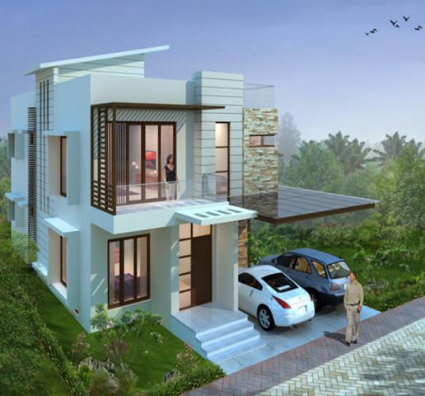
RESIDENTIAL PROJECTS
N V T ORCHID GARDENS
Architect : N V T Life Style
Height : 10 Meters
Floor Count : Ground + 2 Floors (56 Villas)
Nadig Consulting
Design Consultancy and Project Delivery

Slide 50
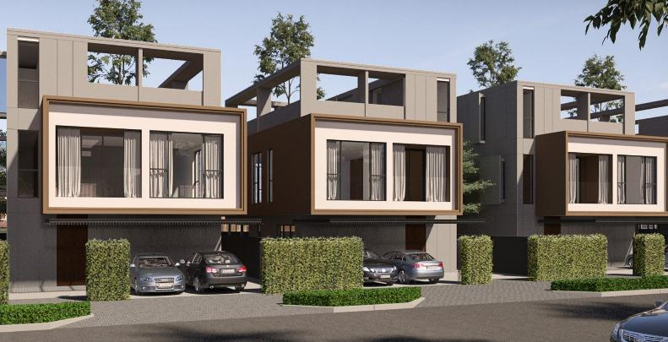
RESIDENTIAL PROJECTS
EMBASSY SPRINGS VILLAS
Architect : A F W Singapore
Height : 10 Meters
Floor Count : Ground + 1 Floors + Terrace (300 Villas)
Nadig Consulting
Design Consultancy and Project Delivery

Slide 51
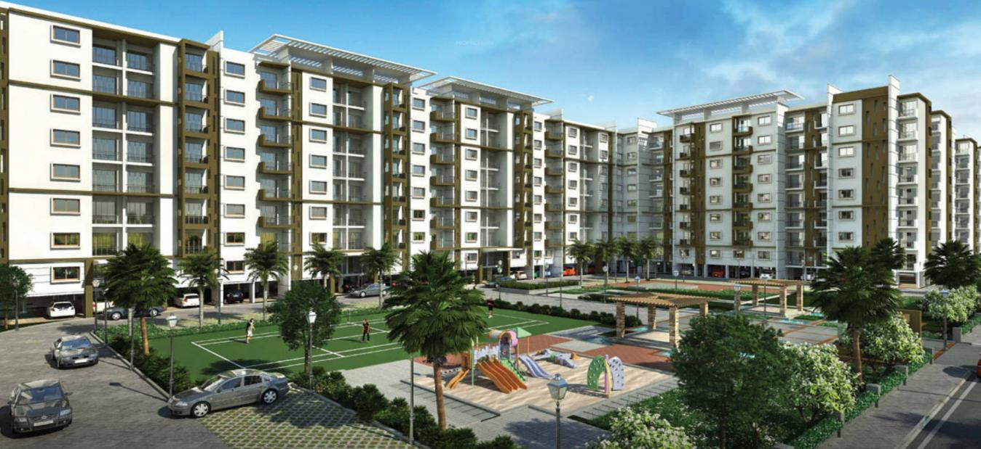
RESIDENTIAL PROJECTS
OZONE URBANA PAVILION
Architect : R S P Consultants
Height : 26.7 Meters
Floor Count : Stilt + Ground + 7 Floors (5 Blocks 10 Towers)
Nadig Consulting
Design Consultancy and Project Delivery

Slide 52
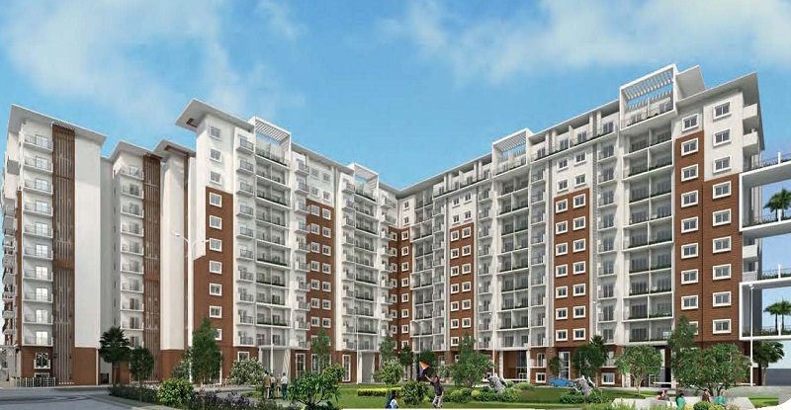
RESIDENTIAL PROJECTS
OZONE URBANA AVENUE
Architect : R S P Consultants
Height : 43.3 Meters
Floor Count : Basement + Ground + 12 Floors ( 23 Towers)
Nadig Consulting
Design Consultancy and Project Delivery

Slide 53
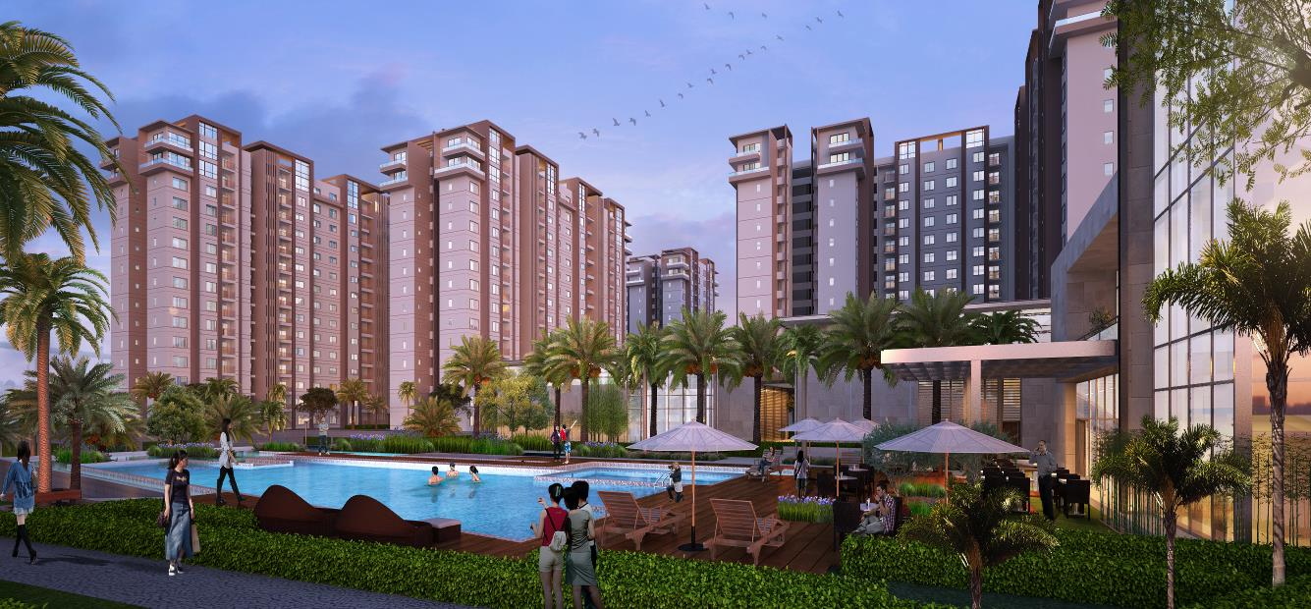
RESIDENTIAL PROJECTS
EMBASSY SPRINGS APARTMENTS
Architect : Synergy
Height : 50 Meters
Floor Count : Basement + Ground + 14 Floors ( 5 Towers)
Nadig Consulting
Design Consultancy and Project Delivery

Slide 54
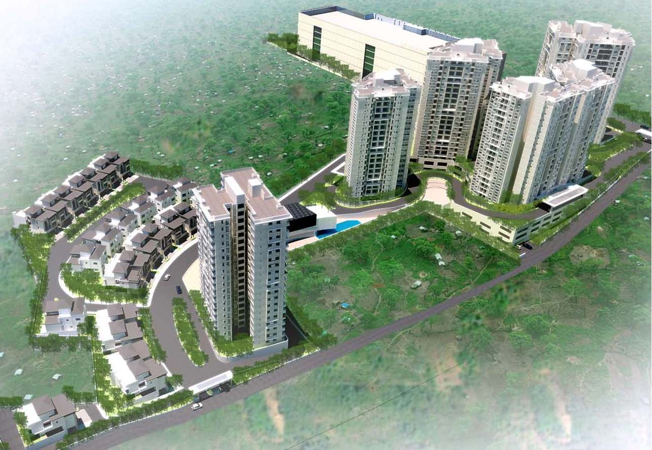
RESIDENTIAL PROJECTS
PRESTIGE HILLSIDE GATEWAY
Architect : Zachariah Consultants
Height : 62 Meters
Floor Count : 3 Basements + Ground + 18 Floors + Terrace
Status : Design Completed
Nadig Consulting
Design Consultancy and Project Delivery

Slide 55
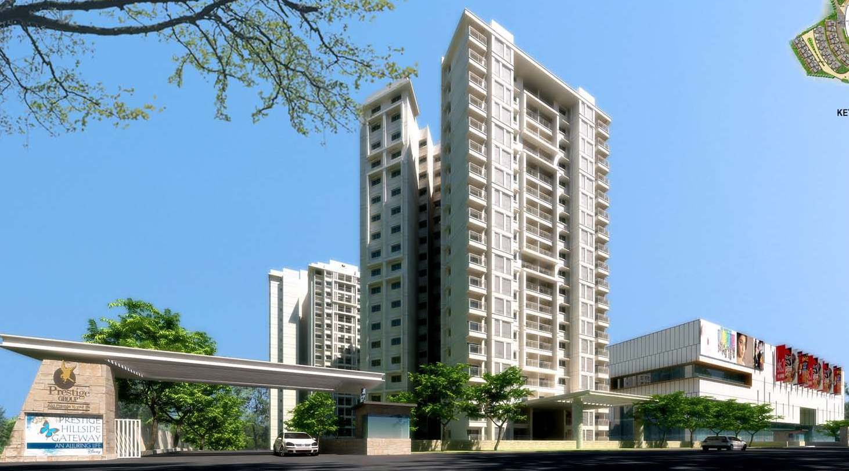
RESIDENTIAL PROJECTS
PRESTIGE HILLSIDE GATEWAY
Nadig Consulting
Design Consultancy and Project Delivery

Slide 56
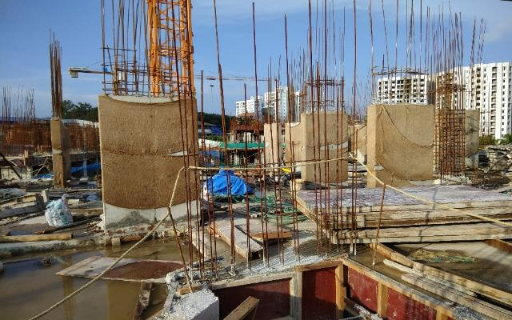
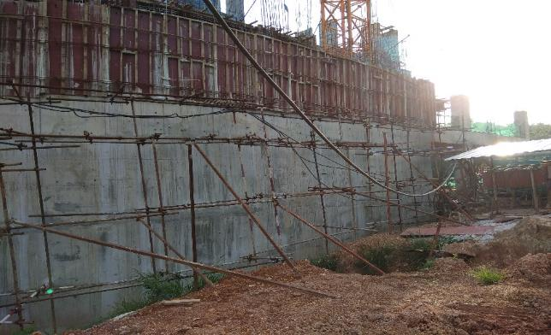
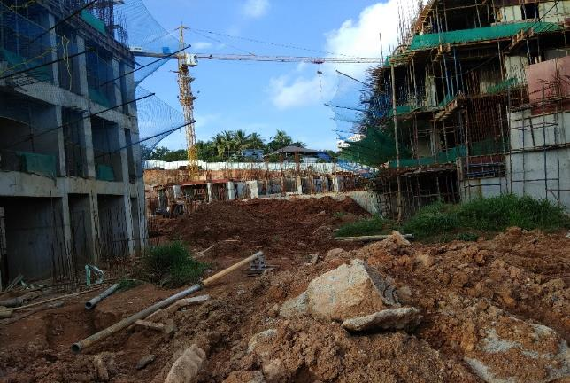
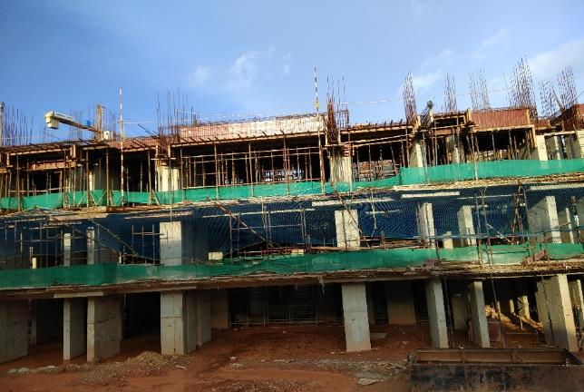
RESIDENTIAL PROJECTS
PRESTIGE HILLSIDE GATEWAY
Nadig Consulting
Design Consultancy and Project Delivery

Slide 57
RESIDENTIAL PROJECTS
INKEL – ANGAMALY BUILDING 2 & 3
Architect : Concepetual Design Studio
Height : 23.4
Floor Count : Ground + 6 Floors + Terrace
Status : On Going
Nadig Consulting
Design Consultancy and Project Delivery

Slide 58
RESIDENTIAL PROJECTS
RHYTHM OF LIFE - 8 VILLAS
Architect : Kembhavi Architects
Height : 7 Meters
Floor Count : Ground + 1 Upper Floor + Terrace
Status : Design Completed
Nadig Consulting
Design Consultancy and Project Delivery

Slide 59
RESIDENTIAL PROJECTS
THE CLUB 44
Architect : Sajith and Vivek, Chennai
Height : 7 Meters
Floor Count : Ground + 1 Upper Floor + Terrace
Status : Design Completed
Nadig Consulting
Design Consultancy and Project Delivery

Slide 60
RESIDENTIAL PROJECTS
ICLOUD - WINDS OF CHANGE
Architect : Sajith and Vivek, Chennai
Height : 7 Meters
Floor Count : Ground + 1 Upper Floor + Terrace
Status : Design Completed
Nadig Consulting
Design Consultancy and Project Delivery

Slide 61
RESIDENTIAL PROJECTS
SHOBHA GIFT CITY, AHMEDABAD
Architect : Shobha Limited, Bangalore
Height : 105 Meters Tower A & B
Floor Count : Basement + Ground + 33 Floors
Design : Ongoing
Nadig Consulting
Design Consultancy and Project Delivery

Slide 62
RESIDENTIAL PROJECTS
SANKALP TEMPLE TREE
Architect : Vernekar and Associates
Height : 25 Meters
Floor Count : Basement + Ground + 7 Floors
Status : Design Completed
Nadig Consulting
Design Consultancy and Project Delivery

Slide 63
RESIDENTIAL PROJECTS
SAMUDHURA ASPIRE, BANGLAORE
Architect : Samudhura
Height : 32 Meters
Floor Count : Basement + Ground + 7 Floors
Status : Design Completed
Nadig Consulting
Design Consultancy and Project Delivery

Slide 64
RESIDENTIAL PROJECTS
BASHYAAM CROWN RESIDENCIES, KOYAMBEDU CHENNAI
Architect : cNT Architects
Height : 102 Meters
Floor Count : 2 Basement + Stilt + 29 Floors + Terrace
Status : Design Under Process
Nadig Consulting
Design Consultancy and Project Delivery

Slide 65
RESIDENTIAL PROJECTS
ESTEEM SOUTH PARK
Architect : Architect Inc
Height : 49 Meters
Floor Count : Basement + Ground + 14 Floors
Status : Design Ongoing
Nadig Consulting
Design Consultancy and Project Delivery

Slide 66
RESIDENTIAL PROJECTS
AMARA RAJA APARTMENTS AT TIRUPATHI
Architect : Kembhavi Architects
Height : 15 Meters
Floor Count : Stilt + Ground + 4 Floors
Status : Design Ongoing
Nadig Consulting
Design Consultancy and Project Delivery

Slide 67
RESIDENTIAL PROJECTS
B R R CLASSIC PHASE 1
Architect :
Height : 15 Meters
Floor Count : Ground + 5 Floors
Status : Design Ongoing
Nadig Consulting
Design Consultancy and Project Delivery

Slide 68
INDUSTRIAL PROJECTS
Nadig Consulting
Design Consultancy and Project Delivery

Slide 69
INDUSTRIAL PROJECTS
Bosch Rexroth, Ahamedabad
Architect : Venkataramanan Associates
Project Features: Main Production Hanger & Other Facilities
Design Status : Completed
Nadig Consulting
Design Consultancy and Project Delivery

Slide 70
INDUSTRIAL PROJECTS
Bosch Rexroth, Ahmedabad
Nadig Consulting
Design Consultancy and Project Delivery

Slide 71
INDUSTRIAL PROJECTS
Bosch Nashik
Architect : Venkataramanan Associates
Project Features : RCC & PEB Structure
Design Status : Completed
Nadig Consulting
Design Consultancy and Project Delivery

Slide 72
INDUSTRIAL PROJECTS
Bosch Verna, Goa
Architect : Venkataramanan Associates
Project Features : PEB Structure + 2 Storey Admin Block
Design Status : Completed
Nadig Consulting
Design Consultancy and Project Delivery

Slide 73
INDUSTRIAL PROJECTS
Bosch Coimbatore
Architect : Venkataramanan Associates
Project Features : IT Park, Sports Complex and Multilevel Car Park
Design Status : Completed
Nadig Consulting
Design Consultancy and Project Delivery

Slide 74
INDUSTRIAL PROJECTS
Bosch Coimbatore
Nadig Consulting
Design Consultancy and Project Delivery

Slide 75
INDUSTRIAL PROJECTS
Bosch Jalgaon
Architect : Venkataramanan Associates
Project Features : Industrial Building with PEB Structure
Design Status : Completed
Nadig Consulting
Design Consultancy and Project Delivery

Slide 76
INDUSTRIAL PROJECTS
Bosch Jalgaon
Nadig Consulting
Design Consultancy and Project Delivery

Slide 77
INDUSTRIAL PROJECTS
SABiC China
Architect : Venkataramanan Associates
Project Features : R & D Centre and Admin Blocks
Design Status : Completed
Nadig Consulting
Design Consultancy and Project Delivery

Slide 78
INDUSTRIAL PROJECTS
McCain India, Mehsana
Architect : P M Group
Project Features : Food Manufacturing Unit
Design Status : Completed
Nadig Consulting
Design Consultancy and Project Delivery

Slide 79
INDUSTRIAL PROJECTS
Xchanging Campus, Shimoga
Architect : Venkataramanan Associates
Project Features : BPO & Call Center Facilities
Design Status : Completed
Nadig Consulting
Design Consultancy and Project Delivery

Slide 80
INDUSTRIAL PROJECTS
Maktheshim Agan
Architect : Venkataramanan Associates
Project Features : Corporate Office, Research & Development Centre
Design Status : Completed
Nadig Consulting
Design Consultancy and Project Delivery

Slide 81
INDUSTRIAL PROJECTS
S K F
Architect : Venkataramanan Associates
Project Features : Global Technology Centre.
Design Status : Completed
Nadig Consulting
Design Consultancy and Project Delivery

Slide 82
INDUSTRIAL PROJECTS
U S Pharmacopeia, Hyderabad
Architect : Venkataramanan Associates
Project Features : Headquarter Building and Research Labs
Design Status : Completed
Nadig Consulting
Design Consultancy and Project Delivery

Slide 83
INDUSTRIAL PROJECTS
G V K LifeScience, Hyderabad
Architect : Venkataramanan Associates
Project Features : R & D Lab and Admin Offices
Design Status : Completed
Nadig Consulting
Design Consultancy and Project Delivery

Slide 84
INDUSTRIAL PROJECTS
Bengal Aetropolis, Airport
Architect : Surbana Architects
Design Status : Completed
Nadig Consulting
Design Consultancy and Project Delivery

Slide 85
INDUSTRIAL PROJECTS
ITC Ranjangoan, Pune
Architect : Venkataramanan Associates
Project Features : Warehouse & Ancillary Structures
Design Status : Completed
Nadig Consulting
Design Consultancy and Project Delivery

Slide 86
INDUSTRIAL PROJECTS
Lonza
Architect : Venkataramanan Associates
Floor Count : Ground + 3 Floors
Design Status : Completed
Nadig Consulting
Design Consultancy and Project Delivery

Slide 87
INDUSTRIAL PROJECTS
AIR INDIA, SATS
Architect : D S A Group
Project Features : Largest Cold Storage unit & Perishable Cargo
Design Status : Completed
Nadig Consulting
Design Consultancy and Project Delivery

Slide 88
INDUSTRIAL PROJECTS
LAAP INDIA, PRODUCTION UNIT AT JIGANI, BANGALORE
Architect : Creative Source
Project Features : Production Unit & Laboratory
Design Status : Completed
Nadig Consulting
Design Consultancy and Project Delivery

Slide 89
INDUSTRIAL PROJECTS
PRESTIGE MORPH FACTORY AT MALUR, BANGALORE
Architect : Kembhavi Architects
Project Features : Logistic Centre & Furniture Manufacturing Facility
Design Status : Ongoing
Nadig Consulting
Design Consultancy and Project Delivery

Slide 90
CORPORATE PROJECTS
Nadig Consulting
Design Consultancy and Project Delivery

Slide 91
CORPORATE PROJECTS
Bosch Adugodi – Ban 603 605
Architect : R S P
Height : 36 Meters & 24 Meters
Floor Count : Ground + 12, Ground +7 and Connecting Bridge
Design Status : Design Under Progress
Nadig Consulting
Design Consultancy and Project Delivery

Slide 92
COMMERCIAL PROJECTS
Nadig Consulting
Design Consultancy and Project Delivery

Slide 93
COMMERCIAL PROJECTS
Prestige Falcon Mall, Bangalore
Architect : Venkataraman Associates
Height : 40 Meters
Floor Count : 2 Basement + Ground + 6 Floors
Design Status : Design Under Progress
Nadig Consulting
Design Consultancy and Project Delivery

Slide 94
COMMERCIAL PROJECTS
Prestige Falcon Mall, Bangalore
Nadig Consulting
Design Consultancy and Project Delivery

Slide 95
COMMERCIAL PROJECTS
Prestige Falcon Mall, Bangalore
Nadig Consulting
Design Consultancy and Project Delivery

Slide 96
COMMERCIAL PROJECTS
Hillside Gateway Forum Mall
Architect : R S P
Area : 7,00,000 Sft
Floor Count : 2 Basement + Ground + 5 Floors + Terrace
Design Status : Design Under Progress
Nadig Consulting
Design Consultancy and Project Delivery

Slide 97
COMMERCIAL PROJECTS
LIFESTYLE MALL, VISHAKAPATNAM
Architect : Nadig Associates
Area : 5,00,000 Sft Height : 18 Meters
Floor Count : 2 Basement + Ground + 2 Floors + Terrace
Design Status : Design Completed
Nadig Consulting
Design Consultancy and Project Delivery

Slide 98
COMMERCIAL PROJECTS
Forum Cochin Mall, Cochin
Architect : R S P
Height : 30 Meters
Floor Count : 2 Basement + Ground + 5 Floors + Terrace
Design Status : Design Completed
Nadig Consulting
Design Consultancy and Project Delivery

Slide 99
COMMERCIAL PROJECTS
Brigade Magnum
Architect : Zachariah Consultants
Height : 30 Meters
Floor Count : 2 Basement + Ground + 9 Floors
Design Status : Design Completed
Nadig Consulting
Design Consultancy and Project Delivery

Slide 100
COMMERCIAL PROJECTS
Prestige Trade Towers
Architect : R. S. P.
Height : 102 Meters
Floor Count : 2 Basement + Ground + 23 Floors
Status : Design Completed
Nadig Consulting
Design Consultancy and Project Delivery

Slide 101
COMMERCIAL PROJECTS
Prestige Saleh Ahmed Commercial Complex, Bangalore
Architect : Thomas Associates
Height : 43 Mtrs
Floor Count : 2 Basement + Ground + 9
Status : Design under Progress
Nadig Consulting
Design Consultancy and Project Delivery

Slide 102
COMMERCIAL PROJECTS
Prestige VST Towers, M G Road, Bangalore
Architect : Venkataraman Associates
Height : 40 Mtrs
Floor Count : 2 Basement + Ground + 9
Status : Design Completed
Nadig Consulting
Design Consultancy and Project Delivery

Slide 103
COMMERCIAL PROJECTS
Bagmane Lynx
Architect : D P Architects
Height : 66 Meters
Floor Count : 3 Basement + Ground + 13 Floors
Status : Design Under Progress
Nadig Consulting
Design Consultancy and Project Delivery

Slide 104
COMMERCIAL PROJECTS
Smart City, Commercial Building
Architect : B + H Architects
Height : 25 Meters
Floor Count : Lower Ground + Ground + 5 Floors
Status : Design Completed
Nadig Consulting
Design Consultancy and Project Delivery

Slide 105
COMMERCIAL PROJECTS
Prestige Smart City
Parcel 1
Parcel 2
Architect : R S P
Height : 45 Meters
Floor Count : 2 Basement + Ground + 9 Floors
Status : Design Under Progress
Nadig Consulting
Design Consultancy and Project Delivery

Slide 106
COMMERCIAL PROJECTS
Prestige Central Street , Bangalore
Architect : R S P Consultants
Height : 42 Mtrs
Floor Count : 2 Basement + Ground + 7 Floors + Terrace
Status : Design Under Progress
Nadig Consulting
Design Consultancy and Project Delivery

Slide 107
COMMERCIAL PROJECTS
R K IT Towerz, Vijayawada
Architect : Team One India Pvt Ltd.,
Height : 100 Mtrs
Floor Count : 2 Basement + Ground + 22 Floors + Terrace
Status : Design Under Progress
Nadig Consulting
Design Consultancy and Project Delivery

Slide 108
COMMERCIAL PROJECTS
S B R – KEERTHI – MIX DEVELOPMENT
Architect : Nadig Associates
Height : Commercial – 38 M, Residential – 53 M
Floor Count : 2B + G+ 5, 2B + G + 14 Floors + Club House
Status : Design Completed
Nadig Consulting
Design Consultancy and Project Delivery

Slide 109
COMMERCIAL PROJECTS
BAGMANE CAPITOL LUXOR
Architect : BIAS Architecture
Height : 44 Meters
Floor Count : 2B + Ground + 8 Floors + Terrace
Status : Design Completed
Nadig Consulting
Design Consultancy and Project Delivery

Slide 110
COMMERCIAL PROJECTS
EMBASSY TAURUS ETTZ - TRIVANDRUM
Architect : R S P
Height : 52 Meters
Floor Count : 1 Basement + Ground + 11 Floors
Status : Design Completed
Nadig Consulting
Design Consultancy and Project Delivery

Slide 111
COMMERCIAL PROJECTS
CITRUS VERMAPOLIS – IT PARK AT HEBBAL, BANGLAORE
Architect : BIAS Architecture
Height : 60 Mtrs
Floor Count : 3 Basement + Ground + 15 Floors + Terrace
Status : Design Under Progress
Nadig Consulting
Design Consultancy and Project Delivery

Slide 112
COMMERCIAL PROJECTS
SHIVAMOGGA AIRPORT, SHIVAMOGGA
Architect : Kembhavi Architecture
Status : Under Process
Nadig Consulting
Design Consultancy and Project Delivery

Slide 113
COMMERCIAL PROJECTS
SIEMENS HEALTHINEER
Height : 60 Meters
Floor Count : 1 Basement + Ground + 16 Upper Floors
Status : Design Ongoing
Nadig Consulting
Design Consultancy and Project Delivery

Slide 114
COMMERCIAL PROJECTS
BANGALORE MARMON TEMPLE
Architect : M Moser
Height : 60 Meters
Floor Count : 1 Basement + Ground + 5 Upper Floors
Status : Design Ongoing
Nadig Consulting
Design Consultancy and Project Delivery

Slide 115
COMMERCIAL PROJECTS
Prestige Falcon City Auditorium
Architect : Venkataraman Associates
Area : 2,10,000 Sft
Floor Count : 2 Basement + Ground + 5 Floors
Design Status : Design Under Progress
Nadig Consulting
Design Consultancy and Project Delivery

Slide 116
INSTITUTIONAL PROJECTS
Nadig Consulting
Design Consultancy and Project Delivery

Slide 117
INSTITUTIONAL PROJECTS
Oak Tree International School
Nadig Consulting
Design Consultancy and Project Delivery

Slide 118
INSTITUTIONAL PROJECTS
J N C A S R
Nadig Consulting
Design Consultancy and Project Delivery

Slide 119
INSTITUTIONAL PROJECTS
KRIES SCHOOLS
Nadig Consulting
Design Consultancy and Project Delivery

Slide 120
HOSPITAL PROJECTS
Nadig Consulting
Design Consultancy and Project Delivery

Slide 121
HOSPITAL PROJECTS
Rainbow Hospital, Bangalore
Architect : R S P
Height : 20 Meters
Floor Count : 2 Basement + Ground + 5 Floors
Design Status : Completed
Nadig Consulting
Design Consultancy and Project Delivery

Slide 122
HOSPITAL PROJECTS
INKEL MEDICAL COLLEGE, P G QARTERS, STAFF QUARERS & SUPER SPECILITY BLOCK
Architect : Inkel Group
Status : Design Ongoing
Nadig Consulting
Design Consultancy and Project Delivery

Slide 123
PROJECTS OUTSIDE
INDIA
Nadig Consulting
Design Consultancy and Project Delivery

Slide 124
PROJECTS OUTSIDE INDIA
S O A S MOSQUE, BRUNEI
Nadig Consulting
Design Consultancy and Project Delivery

Slide 125
PROJECTS OUTSIDE INDIA
U B D CONVENTION CENTRE, BRUNEI
Nadig Consulting
Design Consultancy and Project Delivery

Slide 126
PROJECTS OUTSIDE INDIA
I B B HEADQUARTERS, BRUNEI
Nadig Consulting
Design Consultancy and Project Delivery

Slide 127
PROJECTS OUTSIDE INDIA
CALEDONIAN COLLEGE OF ENGINEERING, MUSCAT
Nadig Consulting
Design Consultancy and Project Delivery

Slide 128
PEER REVIEW
Nadig Consulting
Design Consultancy and Project Delivery

Slide 129
PEER REVIEW
Embassy Pristine
Nadig Consulting
Design Consultancy and Project Delivery

Slide 130
PEER REVIEW
Embassy Lake Terraces
Nadig Consulting
Design Consultancy and Project Delivery

Slide 131
PEER REVIEW
Syngenta, Goa
Nadig Consulting
Design Consultancy and Project Delivery

Slide 132
PEER REVIEW
Gold Tower Apartments, Kochi
Nadig Consulting
Design Consultancy and Project Delivery

Slide 133
PEER REVIEW
Mall of Joy, Kochi
Nadig Consulting
Design Consultancy and Project Delivery

Slide 134
PEER REVIEW
Unishire Terraza
Nadig Consulting
Design Consultancy and Project Delivery

Slide 135
PEER REVIEW
Unishire Belvedere Signature
Nadig Consulting
Design Consultancy and Project Delivery

Slide 136
PEER REVIEW
Unishire Belvedere Premia
Nadig Consulting
Design Consultancy and Project Delivery

Slide 137
PEER REVIEW
Manyata Block L3
Nadig Consulting
Design Consultancy and Project Delivery

Slide 138
PEER REVIEW
Pardhanani Wilshire II
Nadig Consulting
Design Consultancy and Project Delivery

Slide 139
PROJECT AND COST MANAGEMENT
Nadig Consulting
Design Consultancy and Project Delivery

Slide 140
PROJECT AND COST MANAGEMENT SERVICES
Prestige Oasis,
Bangalore
Nadig Consulting
Design Consultancy and Project Delivery

Slide 141
PROJECT AND COST MANAGEMENT SERVICES
Prestige Golfshire,
Bangalore
Nadig Consulting
Design Consultancy and Project Delivery

Slide 142
PROJECT AND COST MANAGEMENT SERVICES
Prestige White Meadows,
Bangalore
Nadig Consulting
Design Consultancy and Project Delivery

Slide 143
PROJECT AND COST MANAGEMENT SERVICES
Prestige Silver Oak,
Bangalore
Nadig Consulting
Design Consultancy and Project Delivery

Slide 144
PROJECT AND COST MANAGEMENT SERVICES
Prestige Park View,
Bangalore
Nadig Consulting
Design Consultancy and Project Delivery

Slide 145
PROJECT AND COST MANAGEMENT SERVICES
Prestige Mayberry,
Bangalore
Nadig Consulting
Design Consultancy and Project Delivery

Slide 146
PROJECT AND COST MANAGEMENT SERVICES
Karle SEZ,
Bangalore
Nadig Consulting
Design Consultancy and Project Delivery

Slide 147
PROJECT AND COST MANAGEMENT SERVICES
Karle Zenith,
Bangalore
Nadig Consulting
Design Consultancy and Project Delivery

Slide 148
THANK YOU
Nadig Consulting
Design Consultancy and Project Delivery

